Slide 1
THE ERA OF
MOLECULAR GENETICS
PATHOLOGY TODAY
M. EYAD CHATTY . M.D.
F.A.S.C.P - F.C.A.P - F.N.A.S
2025

Slide 2
MORBID ANATOMY
PATHOLOGY
PATHOLOGIC BASIS OF DISEASE
MOLECULAR PATHOLOGY

Slide 3
A NEOPLASM IS ABNORMAL MASS OF TISSUES THE GROWTH OF WHICH EXCEEDS
AND IS UNCOORDINATED WITH THAT OF THE NORMAL TISSUES AND PERSISTS IN THE SAME EXCESSIVE MANNER AFTER SESSATION OF THE STIMULI WHICH EVOKED THE CHANGE
WILLIS 1952

Slide 4
ANAPLASTIC CELL

Slide 5
NEOPLASIA
DNA \ GENETIC DAMAGE – ( MUTATION ) :
-NON – LETHAL
-NON – REPAIRABLE
ALLOWING A SINGLE CLONE OF CELLS TO PROLIFERATE UNCHECKED AND THUS BECOMING IMMORTAL 2006
EPIGENETIC 2016

Slide 6
GENES / MUTATIONS
GENOMIC INSTABILITY

Slide 7
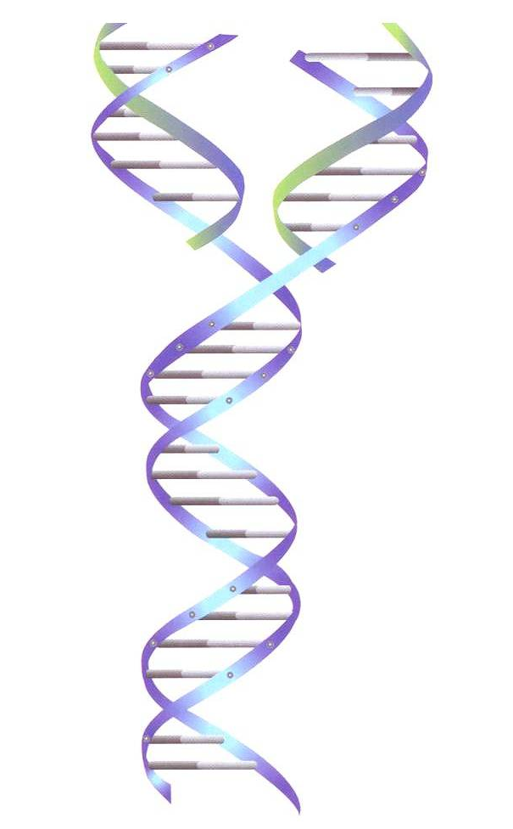
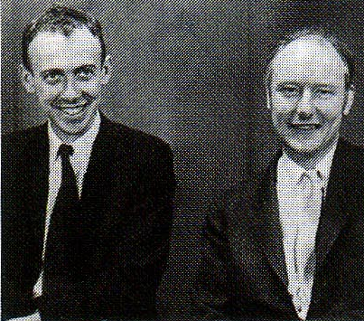
  JAMES WATSON AND FRANCIS CRICK
  In 1953 transform genes from abstract notions into the molecular realm of the DNA double helix .
  Nobel Prize 1962

Slide 8
SRC ONCOGENE
ONLY BY MINING THE RICHES OF THE HUMAN
GENOME WILL WE UNCOVER THE NEXT
GENERATION OF TREATMENTS FOR DISEASE
  MICHAEL BISHOP
  ONCOGENES
  Nobel Prize 1989

Slide 9
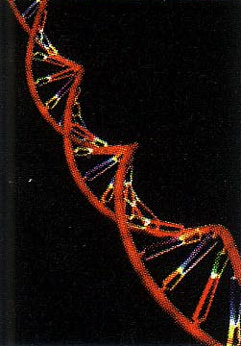
  1989
  The National Center for Human Genome Research

Slide 10
  GENOME PROJECT
  CELERA

Slide 11
2003
THE HUMAN GENOME
  A rough draft of the human genome is
  completed and published by the Human
  Genome Project and Celera .

Slide 12
** HUMAN GENOME :
3.2 BILLION DNA BASE PAIRS

Slide 13
THE ERA OF
MOLECULAR GENETICS

Slide 14
APPLICATIONS in dermatology

Slide 15
MOLECULAR PATHOLOGY OF
MENDELIAN GENETIC SKIN DISORDERS
5000 SINGLE GENE DISORDERS
600
DISTINCT SKIN PHENOTYPE
MANY CHARATERIZED
AT MOLECULAR LEVEL

Slide 16
MOLECULAR PATHOLOGY OF
SKIN CANCER

Slide 17
MOLECULAR PATHOLOGY OF SKIN CANCER
ULTRAVIOLET IRRADIATION
GENETIC/ CHROMOSOMAL CHANGES
INTIATION OF CANCER FORMATION
INCREASED GENOMIC INSTABILITY
LOSS OF HETEROZYGOSITY

Slide 18
BASAL CELL CARCINOMA

Slide 19
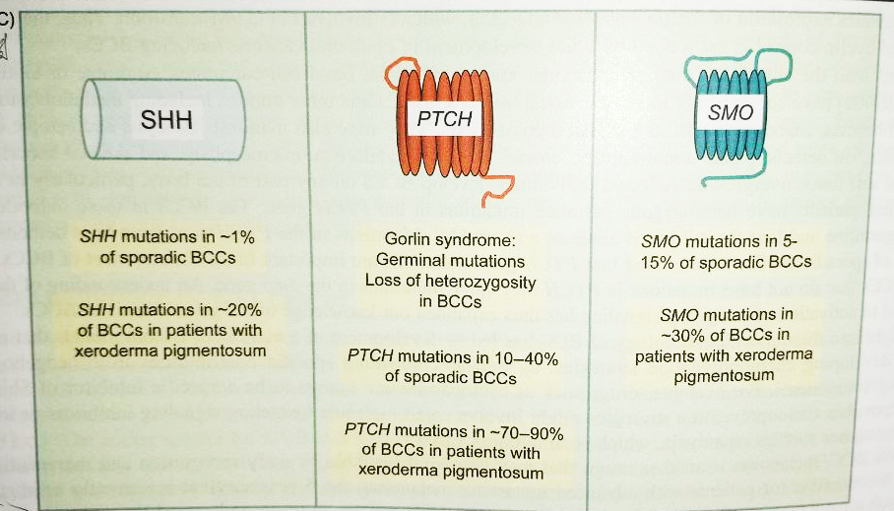
BASAL CELL CARCINOMA
SONIC HEDGEHOG (SHH)
SIGNALING PATHWAY MUTATIONS

Slide 20
APPLICATIONS in CNS

Slide 21
The 2021 WHO Classification
Tumors of the Central Nervous System
Fifth Edition

Slide 22
World Health Organization Classification Of Tumors Of The Central Nervous System (Fifth Edition)
Primary Tumors Of To The CNS
Metastases To The CNS
Genetic Tumor Syndromes

Slide 23
The 2021 WHO Classification of Tumors of the Central Nervous System
General Changes
Specific Changes
CNS Tumor Taxonomy
Gliomas, Glioneuronal and Neuronal T.
CNS Tumor Nomenclature
Choroid Plexus Tumors
Gene and Protein Nomenclature
Medulloblastomas
CNS Tumor Grading
Other Embryonal Tumors
NOS (Not Otherwise Specified) DX
Pineal Tumors
NEC (Not Elsewhere Classified) DX
Meningiomas
Novel Diagnostic Technologies
Mesenchymal, Non-Meningothelial T.
Integrated and Layered Diagnoses
Nerve Tumors
Newly Recognized Entities
Lymphomas and Histiocytic Tumors
Revised Nomenclature
Tumors of the Sellar Region

Slide 24
The 2021 WHO Classification of Tumors of the Central Nervous System
Novel Diagnostic Technologies
Light Microscopy
DNA Fluorescence In Situ H.
Molecular Profiling Approaches
Electron Microscopy
DNA And RNA Sequencing
RNA Expression Profiling
Immunohistochemistry
Molecular Genetics
Unusual Morphological Features
&
Small Biopsy Samples
Defining Genetic Alteration
DNA Methylation Patterns
The Methylome Refers To The Total Distribution Of 5mc Throughout The Genome

Slide 25
The 2021 WHO Classification of Tumors of the Central Nervous System
General Changes
Specific Changes
CNS Tumor Taxonomy
Gliomas, Glioneuronal and Neuronal T.
CNS Tumor Nomenclature
Choroid Plexus Tumors
Gene and Protein Nomenclature
Medulloblastomas
CNS Tumor Grading
Other Embryonal Tumors
NOS (Not Otherwise Specified) DX
Pineal Tumors
NEC (Not Elsewhere Classified) DX
Meningiomas
Novel Diagnostic Technologies
Mesenchymal, Non-Meningothelial T.
Integrated and Layered Diagnoses
Nerve Tumors
Newly Recognized Entities
Lymphomas and Histiocytic Tumors
Revised Nomenclature
Tumors of the Sellar Region

Slide 26
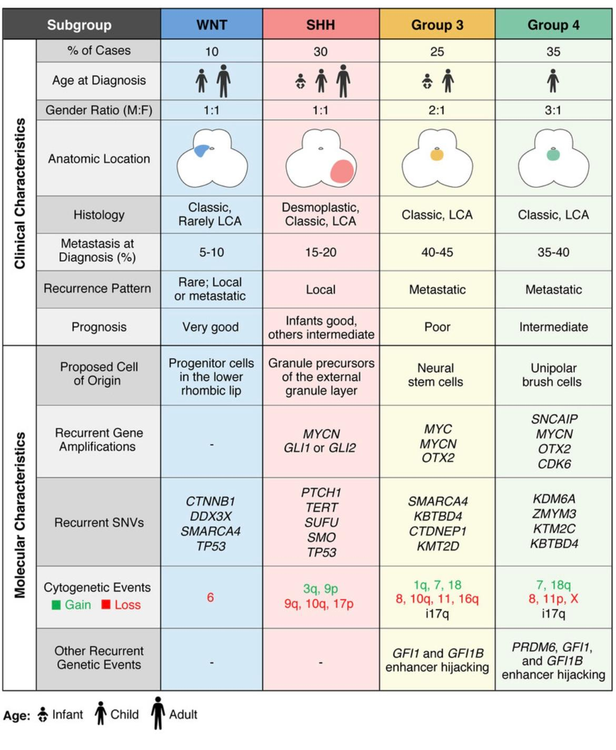

Slide 27
APPLICATIONS in OPHTHALMOLOGY

Slide 28
Gene therapy for
MULTIPLE DISEASES
HEREDITARY EYE DISEASES
MACULAR DEGENERATION

Slide 29
“INHERITED RETINAL DEGENERATION”
RETINITIS PIGMENTOSA (RP)
LEVER CONGENITAL AMAUROSIS (LCA)
USHER SYNDROME (USH)
CONGENITAL STATIONARY NOIGHT BLINDNESS (CSNB)
VITELLIFORM MACULAR DYSTROPHY
STARGARDR DISEASE
AGE RELATED MACULAR DEGENERATION AMD
LEVER HEREDITARY OPTIC NEUROPATHY LHON

Slide 30
IMMENSE GENETIC HETEROGENEITY INHERENT IN THIS GROUP OF CONDITIONS
~ 250 GENES
70 INHERITED
IN
DOMINANT FASHION

Slide 31
RETINITIS PIGMENTOSA (RP)
~ 60 DISEASE-CAUSING GENES
IMPLICATED TO DATE
WWW.SPH.UTH.EDU/RETNET/
1ST XlRP
RP2 GENE
1ST adRP
Rhodopsin (RHO) GENE

Slide 32
Genotypic characterization of
Disease-Causing Mutations
A prerequisite when designing
Gene Therapies
RETINAL MICROARRAYS
NGS
EXOME & WHOLE GENOME SEQUENCING

Slide 33
GENE THERAPY
for
Dominantly-Inherited Retinal Degeneration
TARGETING PRIMARY GENETIC DEFECT
TARGETING SECONDARY EFFECTS
GENE SUPPRESSION
NEUROTROPHIC FACTORS
GENE AUGMENTATION
MODULATING CELLULAR STRESS
GENE REPLACEMENT

Slide 34
RECOMBINANT VIRUS-MEDIATED GENE DELIVERY
ADENO-ASSOCIATED VIRUSES (AAV)

Slide 35
LIQUID BIOPSY

Slide 36
Liquid Biopsy
Cancer Patient
Liquid Biopsy
History & Clinical Presentation
Tissue Biopsy
Cytology
Imaging Studies
Treatment
Chemotherapy
Radiation
Surgery
Target Therapy
Immunotherapy
Small Molecules
RNA Molecules
Follow up
Tumor markers
CTC
CFDNA
CFRNA
Pt-Scan
Diagnosis
Staging
Management

Slide 37
WHY LIQUID BIOPSY
TUMOR GENOTYPE EVOLVE DURING THERAPY
Required Repeat Biopsies
( Tissue May Not Be Available Any More)
Perform Dynamic Genetic Surveillance
Chemotherapy Eradicate Sensitive Cells
Resistant Cells Continue
to Grow & Proliferate
Tissue
Biopsy
Liquid
Biopsy
Stem Like Cancer Cells
New Clones Of Malignant Cells
Hence The Solution is Blood-Based Analysis of CFDNA/RNA & Over Time
New Standard, Liquid Biopsy:
Serial Blood Biopsies: Contain Dynamic DNA And RNA Information From All Tumor Sites/ Resistant Cells

Slide 38
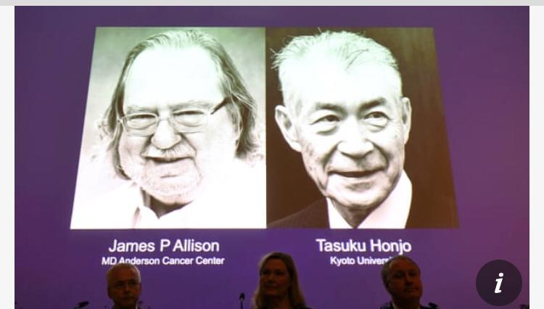
IMMUNOTHERAPY
NOBEL PRIZE
2018

Slide 39
ANTI GENE THERAPY
FDA / MARCH 2019
ALS / STEPHEN HAWKING
  NOBEL PRIZE
  2019

Slide 40

CRISPR/CAS9
“A MOLECULAR SISSORS”
A process using a nuclease called Cas9 that was originally identifed in prokaryotes
that can be used together with guide RNAs called CRISPRs
to selectively alter or correct DNA sequences

Slide 41

  NOBEL PRIZE
  2020

Slide 42
WHAT NEXT

Slide 43
HARVARD STEM CELL INSTITUTE HSCI

Slide 44
FERTILIZED
OVUM
46
ULTIMATE
STEM CELL
PLACENTA
EMBRYO
TOTIPETENTIAL
STEM CELL
PLURIPOTENTIAL
STEM CELL
ULTIMATE
EMBRYONIC
STEM CELL
OLIG0 POTENTIAL
STEM CELL
SC
212 DIFFERENTITATED
CELL
ALL THESE CELLS CARRY THE SAME CHROMOSOMES
WHAT MAKES THE DIFFERENCE AS THEY DIFFERNTIATE ?
** PROGRAMMING **

Slide 45
** REPROGRAMMING TECHNOLOGY **

Slide 46
** NANOTECHNOLOGY **

Slide 47
** ARTIFICIAL INTELLIGENCE **

Slide 48


